Slide 1
MA3077 (DLI) Operational Research Lecture 3&4 - Solving linear programming problems in Matlab and Compressed Sensing
Dr Neslihan Suzen

Slide 2
Lecture outline
This lecture’s goal is to learn:
How to solve linear programming problems in Matlab using linprog.
How to solve a compressed sensing problem using linear programming

Slide 3
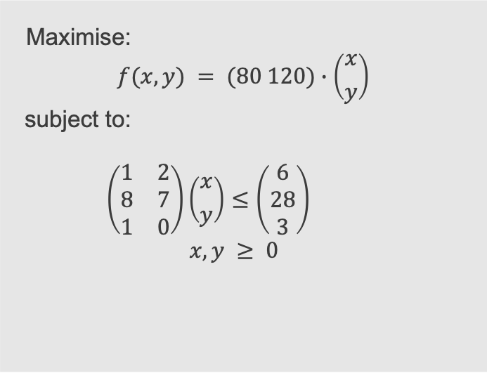
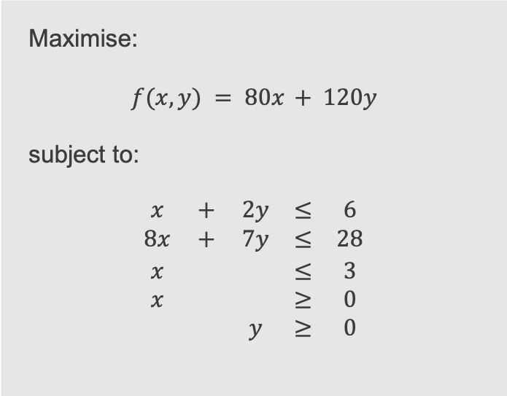
A previous example - formulation
Mathematically, we usually write the problem as follows:
Maximise:
$$f(x,y) = 80x + 120y$$
subject to:
$$\begin{matrix}x & + & 2y & ≤ & 6 \\ 8x & + & 7y & ≤ & 28 \\ x & & & ≤ & 3 \\ x & & & ≥ & 0 \\ & & y & ≥ & 0\end{matrix}$$
Maximise:
$$f(x,y) = (80 120)∙\left({x \atop y}\right)$$
subject to:
$$\left(\begin{matrix}1 & 2 \\ 8 & 7 \\ 1 & 0\end{matrix}\right)\left({x \atop y}\right)≤\left(\begin{matrix}6 \\ 28 \\ 3\end{matrix}\right)$$
$$x,y ≥ 0$$
This is a linear programming problem because both the objective and the constraints can be expressed with linear functions.

Slide 4
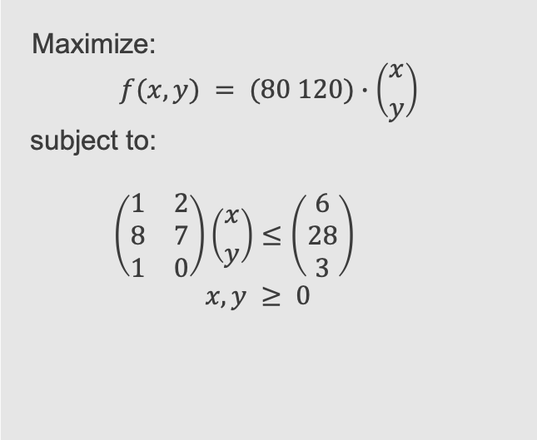
A previous examplem– graphical solution
Maximize:
$$f(x,y) = (80 120)∙\left({x \atop y}\right)$$
subject to:
$$\left(\begin{matrix}1 & 2 \\ 8 & 7 \\ 1 & 0\end{matrix}\right)\left({x \atop y}\right)≤\left(\begin{matrix}6 \\ 28 \\ 3\end{matrix}\right)$$
$$x,y ≥ 0$$

Slide 5
An example – solve in Matlab with linprog (see matlab's documentation - OR03_linprog.m)
% set the problem specs
f = -1*[80;120]; % objective function to minimize
A = [1 2; 8 7; 1 0]; % inequality constraints matrix
b = [6 28 3]; % inequality constraints rhs
Aeq = []; % equality constraints matrix
beq = []; % inequality constraints rhs
lb = zeros(size(f)); % lower bounds
ub = []; % upper bounds
% solve the problem
[x,fval,exitflag,output] = linprog(f,A,b,Aeq,beq,lb,ub);

Slide 6
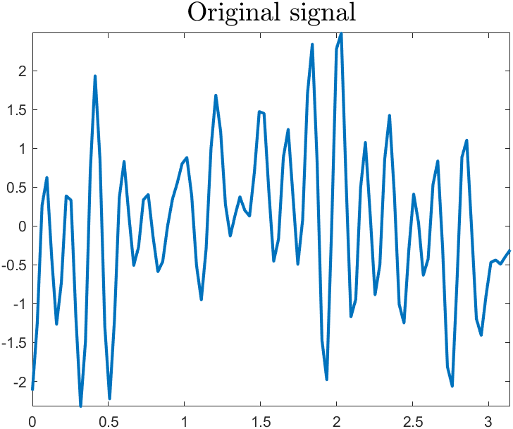
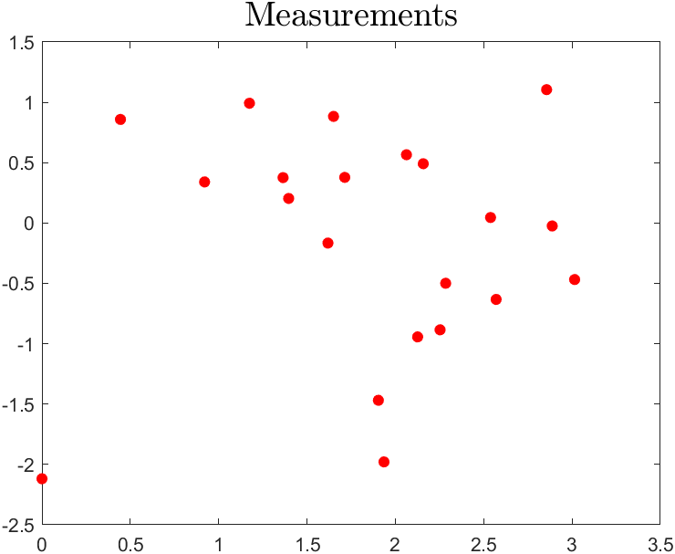
Compressed sensing – an example
Scenario: Your friend is sending you a signal through the aether, but your aether decoder is currently malfunctioning and can only take a discrete number of measurements/samples.
Question: Can you retrieve the signal from these measurements?

Slide 7
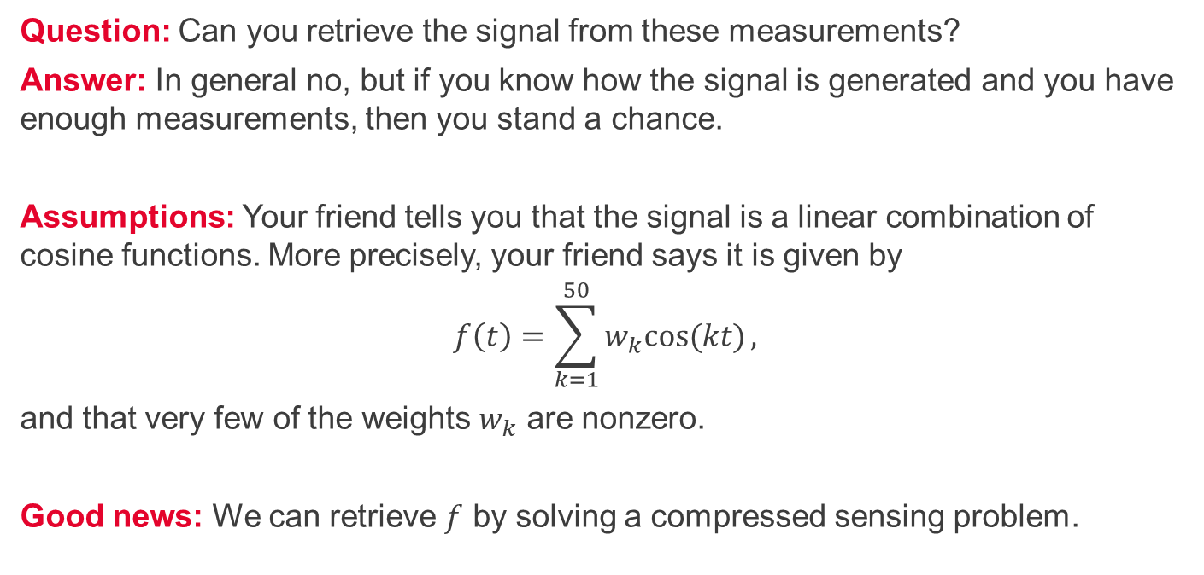
Compressed sensing - questions
Question: Can you retrieve the signal from these measurements?
Answer: In general no, but if you know how the signal is generated and you have enough measurements, then you stand a chance.
Assumptions: Your friend tells you that the signal is a linear combination of cosine functions. More precisely, your friend says it is given by
$$f\left(t\right)=\sum_{k=1}^{50}{w_{k}cos⁡(kt)},$$
and that very few of the weights $w_{k}$ are nonzero.
Good news: We can retrieve $f$ by solving a compressed sensing problem.

Slide 8
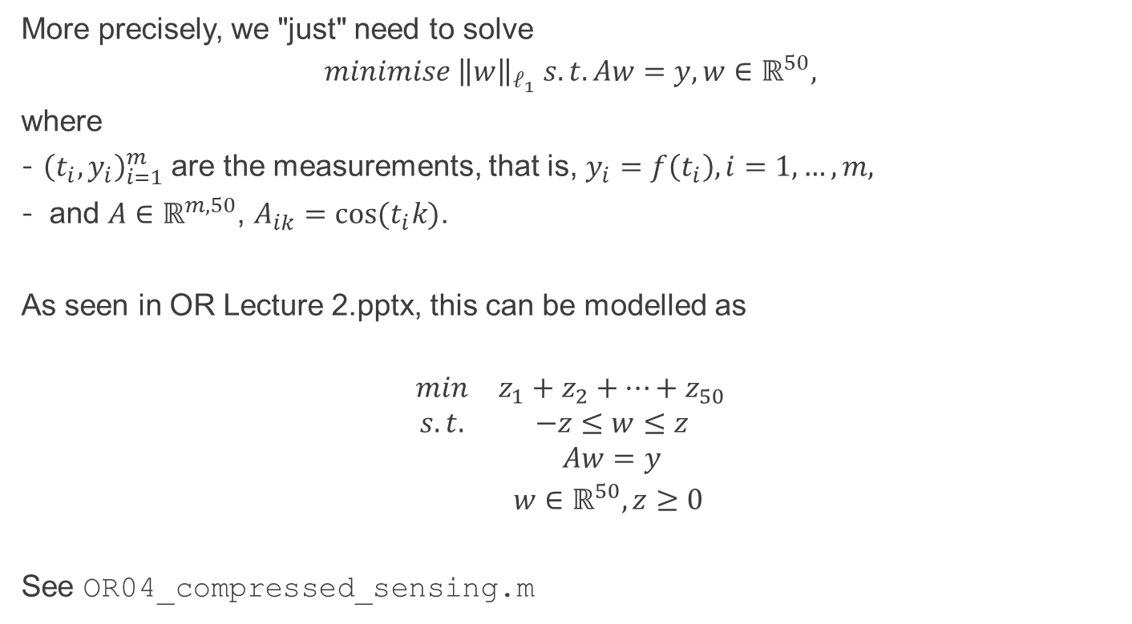
Compressed sensing – mathematical model
More precisely, we "just" need to solve
$$minimise {\left\|w\right\|}_{ℓ_{1}} s.t. Aw=y, w∈ℝ^{50},$$
where
${\left(t_{i},y_{i}\right)}_{i=1}^{m}$are the measurements, that is, $y_{i}=f\left(t_{i}\right), i=1,…, m,$
and $A∈ℝ^{m,50}$, $A_{ik}=cos⁡(t_{i}k)$.
As seen in OR Lecture 2.pptx, this can be modelled as
$$\begin{matrix}min & z_{1}+z_{2}+…+z_{50} \\ s.t. & −z≤w≤z \\ & Aw=y \\ & w∈ℝ^{50}, z≥0 \end{matrix}$$
See OR04_compressed_sensing.m

Slide 9
Summary and self-study
Summary: today we have learnt
how to solve linear programming problems in matlab using linprog.
how to tackle a compressed sensing problem via linear programming.
Self-study:
Solve the self-study problems on the last slide of the slides OR Lecture 2_linear_programming.pptx in Matlab using linprog.
In OR04_compressed_sensing.m, experiment with the parameters number of modes, number of nonzero weights, number of measurements. What do you observe?

